Slide 1

HTTP/Web-Services-POST
M2-12
Participate! The more engagement the better! You are NEVER interrupting me!

Slide 2
Objectives
HTTP GET (continued)
HTTP POST,
HTTP PUT,
HTTP DELETE
Object serialization/deserialization
Handling API Errors

Slide 3
HTTP Methods
GET
The GET method requests a representation of the specified resource. Requests using GET should only retrieve data.
POST
The POST method is used to submit an entity to the specified resource, often causing a change in state or side effects on the server.
PUT
The PUT method replaces all current representations of the target resource with the request payload.
DELETE
The DELETE method deletes the specified resource.
Read more about POST and other methods at: https://developer.mozilla.org/en-US/docs/Web/HTTP/Methods

Slide 4
HTTP Methods - GET
Usage
HTTP GET is generally used to retrieve web pages to display
It also is included for
images
documents
stylesheets, script files
Search Pages
HTTP GET requests are easily bookmarked because the parameters are in the url.
HTTP GET should never modify any data on the server. It is a read-only operation and should have no effect if called multiple times.
Parameters for a GET request travel as either Path Parameters or in the Query String.
:id
http://localhost:3000/hotels/2/reviews?stars=4

Slide 5
HTTP Methods - POST
Usage
HTTP POST is used when
Data must be secure (credit card number, password, etc.)
Data is too large for the URL
When the request is asking to add something on the server
HTTP POST requests cannot be bookmarked or sent with the browser directly.
.
HTTP POST indicates that the request will add new data to the the server.
POST transfers data in the message body instead of the URL. While HTTPS encrypts the message body, it cannot encrypt the URL.

Slide 6
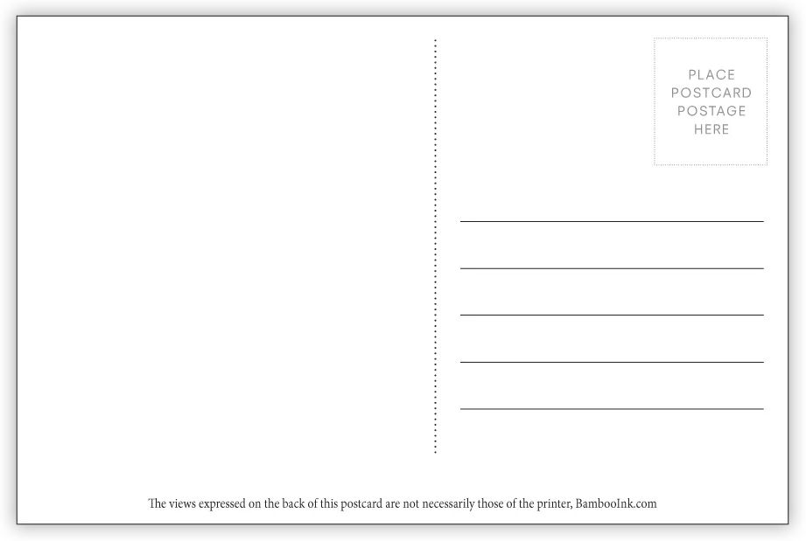
POST vs GET
GET requests can be cached
GET requests remain in the browser history
GET requests can be bookmarked
GET requests should never be used when dealing with sensitive data
GET requests have length restrictions
GET requests are typically used to request data (not modify)
https://thedomain.com/theresource?name=steve&age=16
GET has the parameters clearly visible in the URL

Slide 7

POST vs GET
POST has the data hidden inside the HTTP Body. Only the address to the server/resource is exposed
POST requests are never cached
POST requests do not remain in the browser history
POST requests cannot be bookmarked
POST requests have no restrictions on data length (within server limits)
http://thedomain.com/theresource

Slide 8
HTTP Methods - PUT
Usage
HTTP PUT is used to update existing data
HTTP PUT requests cannot be bookmarked or sent with the browser directly.
.
HTTP PUT indicates that the request will update existing data on the the server.
PUT transfers data in the message body instead of the URL. While HTTPS encrypts the message body, it cannot encrypt the URL.

Slide 9
HTTP Methods - DELETE
Usage
HTTP DELETE is used to remove existing data from the server
HTTP DELETE requests cannot be bookmarked or sent with the browser directly.
.
HTTP DELETE indicates that the request will delete existing data on the the server.

Slide 10
Object Serializing and Deserializing
Transforming a Java Object to a string representation of the object, JSON, is called Serialization.
Object → JSON is Serialization
Transforming a string representation of an object, JSON, into an Java Object is called Deserialization.
JSON → Object is Deserialization

Slide 11
Handling API Errors
RestClientResponseException
Catches common error status codes, like 401 (Unauthorized), 404 (Not Found) , or 500 (Server Exception). HTTP Status Codes: https://en.wikipedia.org/wiki/List_of_HTTP_status_codes
ResourceAccessException
Catches connection errors when the server cannot be reached.
These can be handled using the Java Exception try...catch
try { hotels = restTemplate.getForObject(BASE_URL + "hotels", Hotel[].class); catch (RestClientResponseException e) { // handle common errors } catch (ResourceAccessException e) { // handle connection errors }

Slide 12
Lecture Code
GET http://localhost:3000/hotels
GET http://localhost:3000/hotels/{id}
GET http://localhost:3000/reservations
GET http://localhost:3000/reservations/{id}
GET http://localhost:3000/hotels/{id}/reservations
POST http://localhost:3000/hotels/{id}/reservations
PUT http://localhost:3000/reservations/{id}
DELETE http://localhost:3000/reservations/{id}

Slide 13
Coding a POST
Setting Headers
HttpHeaders headers = new HttpHeaders();
headers.setContentType(MediaType.APPLICATION_JSON);
HttpEntity<Reservation> entity = new HttpEntity<>(reservation, headers);
POST with postForObject()
Reservation res = restTemplate.postForObject(url, entity, Reservation.class);
The HttpEntity object contains the Headers and message Body.
Since we want the reservation to be in the message body instead of the Query String, we set it in the entity object and pass it to the restTemplate.

Slide 14
Coding a PUT
Setting Headers
HttpHeaders headers = new HttpHeaders();
headers.setContentType(MediaType.APPLICATION_JSON);
HttpEntity<Reservation> entity = new HttpEntity<>(reservation, headers);
POST with put()
restTemplate.put(url, entity);

Slide 15
Coding a DELETE
restTemplate.delete(url);

